Slide 1

User Defined Data Types - Structures
Session 12 . a

Slide 2

Structures
Structure is defined to be a user defined data type to represent any entity.
Entity is any real thing to be used in a program like student, employee, bank account, item ..etc
The structure looks like a collection of heterogeneous elements.
Heterogeneous means elements of various data types.

Slide 3
Entity – Property Relation
If Student is an entity, its properties are
  Roll number
  Fee
  Name
  Marks of Various Subjects ..etc.,
If Employee is an entity, its properties are
  Name
  Designation
  Salery ..etc

Slide 4
Entity representation by structure
Structure represents the entity and the entity properties are represented by variables inside the structure.
Syntax:
  struct structName
  {
  variables list;
  };
Example
  struct student
  {
  int rno,m1,m2,m3;
  char name[12];
  };

Slide 5
Structure Member Usage
The variables inside the structure are called the structure members.
As known, these members represent the entity properties.
To store an entity details a structure variable is needed.
These variables are used to access the structure members.
Example:
  struct student s1,s2;
  s1.rno = 10;
  s2.rno = 15;

Slide 6
Session 6
Unions

Slide 7
Session Objectives (1)
Explain what are structures and their use
Define a structure
Declare structure variables
Explain how structure elements are accessed
Explain how structures are initialized
Explain how assignment statements are used with structures
Explain how structures can be passed as arguments
Use with arrays of structures

Slide 8
Session Objectives (2)
Explain the initialization of structure arrays
Explain pointers to structures
Explain how structure pointers can be passed as arguments
Explain what unions are and their use
Explain unions of structures
Explain enumeration

Slide 9

Structures
A structure consists of a number of data items, which need not be
of the same data type, grouped together.
The structure could hold as many of these items as desired.
}
1
I
I
L
L
U
S
I
O
N
B
A
C
H
1
}
Variable
L
L
U
Name of the book
Author
Edition
S
I
Structure
O
N
Array

Slide 10
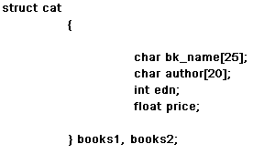
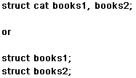
Declaring Structure Variables
A structure can be defined as:
In a program two variables
books1 and books2 of the
structure type cat can be
declared.
The following declaration sets
aside memory for both books1
books2.
As with int, float and other data types there can be any number of
variables of a given structure type

Slide 11
Declaring Structure Variables (1)
Once a new data type has been defined, one or more variables of
that type can be declared.
struct cat books1;
The statement will set aside enough memory to hold all items in the
structure.
The above variable declaration performs a function similar to such
variable declarations as int xyz and float ans.
It tells the compiler to set aside storage for a variable of specific
type and gives a name to the variable.

Slide 12
Initializing Structures (1)
Like variables and arrays, structure variables can be initialized at the
beginning of the program.
Consider the following program :
struct employee {
int no;
char name[20];
};

Slide 13
Initializing Structures (2)
The variable emp1 and emp2 of the type employee can be initialized
when it is declared as
struct employee emp1 = {346, "Abraham" };
struct employee emp1 = {347, "John" };

Slide 14
Accessing Structure Elements
Individual structure elements are referenced through the use of the
dot operator(.) which is also known as the membership operator.
For example, the following code refers to the field bk_name of the
structure variable books1 declared earlier :
books1.bk_name

Slide 15
Assignment Statements Used with Structures
The following statement is valid in C, even though the 2 variables
are structure variables :
books2 = books1;
Also, in cases where direct assignment is not possible the in-built
function memcpy() can be used.
memcpy(char *destn, char *source, int nbytes);

Slide 16
Structures within Structures
It is possible to have one structure within another structure.
struct issue {
char borrower[20];
char dt_of_issue[8];
struct cat books;
}
issl;

Slide 17
Passing Structures as Arguments
A structure variable can be passed as an argument to another
function
This is a useful facility and it is used to pass groups of logically
related data items together instead of passing them one by one.
When a structure is used as an argument, care should be taken that
the type of the argument matches the type of the parameter.

Slide 18
Array of Structures
To declare an array of structures, a structure is first defined,
and then an array variable of that type is declared.
For example, to declare a 50-element array of structures of
type cat, the statement would be :
struct cat books[50];
book[4].author
will refer to the field author of the fourth element of the array
books.

Slide 19


Initializing Structure Arrays
The effective initialization contains nested braces.
Each element is initialized as if some structure is being
initialized.
The whole list is then enclosed within braces to indicate that
the array is being initialized.

Slide 20
Pointers To Structures
The following statement declares ptr_bk as a pointer to data of
that type -
struct cat *ptr_bk;
ptr_bk = &book;
To access the elements of the structure:
ptr_bk->author
or
(*ptr_bk).author

Slide 21

Unions (1)
A union is a memory location that is shared by two or more
variables, generally of different types, at different times.
Defining a union:
Variables can be declared as:
union temp temp1;
Elements can be accessed as:
temp1.i = 13;

Slide 22
Unions (2)
Unions are used frequently when type conversions are needed, as the data held in the union can be read in different ways.
Another use of the union is when a single variable name is to be used to pass data of different types.

Slide 23
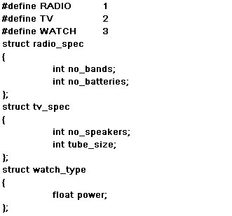
Unions of Structures (1)
It is possible to nest unions within unions, unions in structures,
and structures in unions.

Slide 24
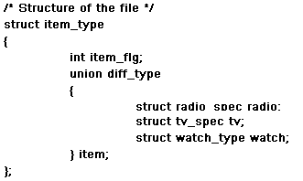
Unions of Structures (2)

Slide 25
Enumerations (1)
An enumeration is a set of named integer constants that specify
all the legal values a variable of that type may have.
An enumeration of the metro towns in India is :
Washington, Holland, New Jersey, California
Enumerations are defined much like structures; the keyword
enum signals the start of an enumeration type.
enum tag {enumeration list} variable_list;

Slide 26
Enumerations (2)
Defining Enumeration:
enum metro{Bombay, Delhi, Madras, Calcutta};
Declaring Enumeration:
enum metro town;
Initializing Enumeration:
town = Bombay;
✓
town = Bangalore;
X
Internally each value on the list of enumeration is treated as an integer, starting with 0.
printf(“%d %d”,Bombay,Madras);
Will display 0,2

Slide 27
Typedef
New data type name can be defined by using the keyword typedef.
This does not create a new data class, but just defines a new
name for an existing type.
The advantage of defining a new name to the existing type
improves the readability and thereby understandability of the
code.
The general syntax of the typedef statement is:
typedef type name;
where type is any allowable data type and name is the new name
for this type.

